Slide 1
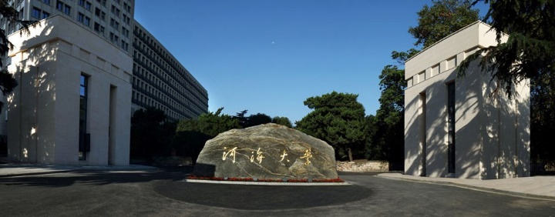
UNET 3+: A FULL-SCALE CONNECTED UNET FOR MEDICAL IMAGE SEGMENTATION
Huimin Huang , Lanfen Lin, Ruofeng Tong, Hongjie Hu, Qiaowei Zhang, Yutaro Iwamoto, Xianhua Han, Yen-Wei Chen, Jian Wu, "Unet 3+: A full-scale connected unet for medical image segmentation", Proc of ICASSP, 2020.
Notes:
“Proc of ICASSP” 是 “Proceedings of the International Conference on Acoustics, Speech, and Signal Processing (ICASSP)” 的缩写，根据 CORE 2018 的排名，IEEE 国际声学、语音和信号处理会议 (ICASSP) 的级别为 B，根据最新的数据，ICASSP 的影响因子为 3.59

Slide 2

Abstract
U-Net, which is one of deep learning networks with an encoder-decoder architecture, is widely used in medical image segmentation. U-Net++ was developed as a modified U-Net by designing an architecture with nested and dense skip connections.
U-Net是一种具有编码器-解码器架构的深度学习网络，广泛应用于医学图像分割。U-Net++ 是通过设计具有嵌套和密集跳跃连接的架构而开发为改进的 U-Net。
However, it does not explore sufficient information from full scales and there is still a large room for improvement.
然而，它没有从全尺度探索足够的信息，仍然有很大的改进空间。
In this paper, we propose a novel U-Net 3+, which takes advantage of full-scale skip connections and deep supervisions.
在本文中，我们提出了一种新颖的 U-Net 3+，它利用了全尺度的跳跃连接和深度监督。

Slide 3
Abstract
The full-scale skip connections incorporate low-level details with high-level semantics from feature maps in different scales; while the deep supervision learns hierarchical representations from the full-scale aggregated feature maps. We further propose a hybrid loss function and devise a classification-guided module to enhance the organ boundary and reduce the over-segmentation in a non-organ image, yielding more accurate segmentation results.
全尺度跳跃连接将低级细节与来自不同尺度特征图的高级语义相结合； 而深度监督则从全尺寸聚合特征图中学习层次表示。并进一步提出了一种混合损失函数。我们进一步提出了一种混合损失函数，并设计了一个分类引导模块来增强器官边界并减少非器官图像中的过度分割，从而产生更准确的分割结果。

Slide 4
Contribution
The full-scale skip connections incorporate low-level details with high-level semantics from feature maps in different scales .
全尺度跳跃连接将低级细节与来自不同尺度特征图的高级语义相结合。
The deep supervision learns hierarchical representations from the full-scale aggregated feature maps.
而深度监督则从全尺寸聚合特征图中学习层次表示。
We further propose a hybrid loss function and devise a classification-guided module to enhance the organ boundary and reduce the over-segmentation in a non-organ image, yielding more accurate segmentation results.
我们进一步提出了一种混合损失函数，并设计了一个分类引导模块来增强器官边界并减少非器官图
像中的过度分割，从而产生更准确的分割结果。

Slide 5
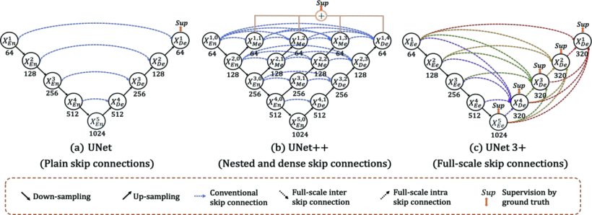
Introduction

Slide 6
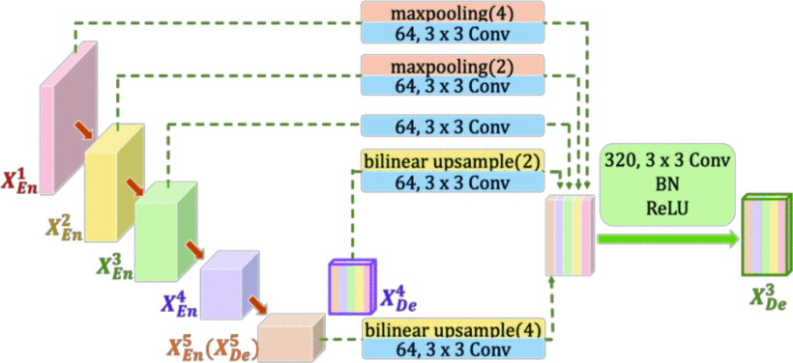
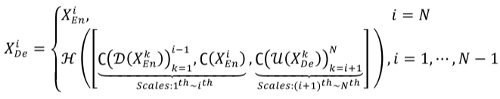
Framework of Method

Slide 7
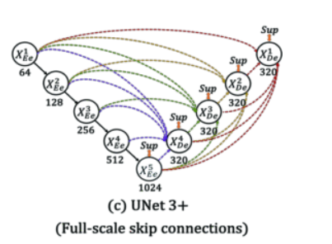
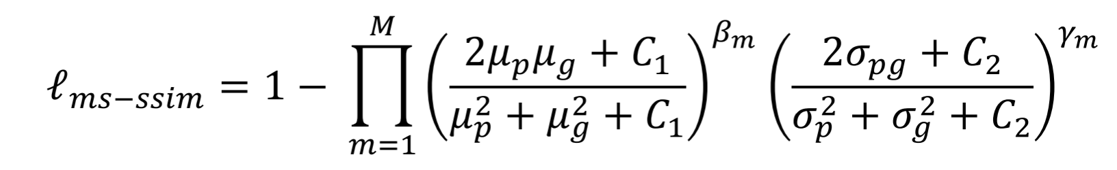
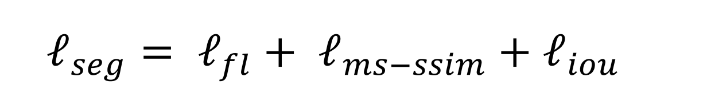
Framework of Method

Slide 8
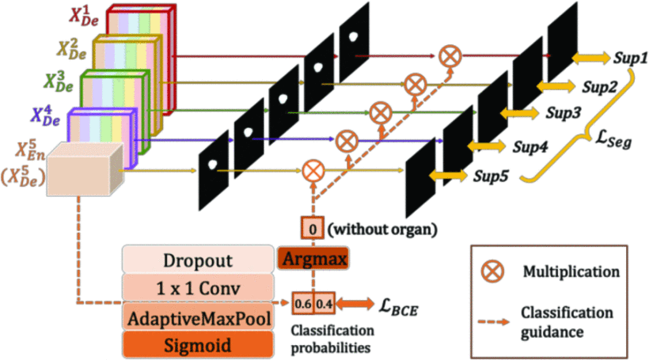
Framework of Method

Slide 9
Datasets
该方法在两个器官上得到了验证：肝脏和脾脏。
肝脏分割数据集来自 ISBI LITS 2017 Challenge。它包含131个增强型3D腹部CT扫描，其中103个CT volumes用于训练，28个CT volumes用于测试。
脾脏数据集来自作者从医院自己采集。它包含49个增强型3D腹部CT扫描，其中40个CT volumes用于训练，9个CT volumes用于和测试。
为了加快训练速度，输入图像具有三个通道，包括待分割的切片和上下切片，裁剪为320×320。

Slide 10
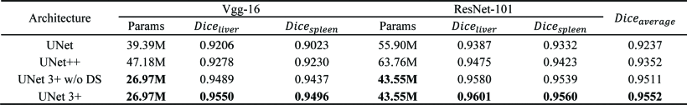
Experiment

Slide 11
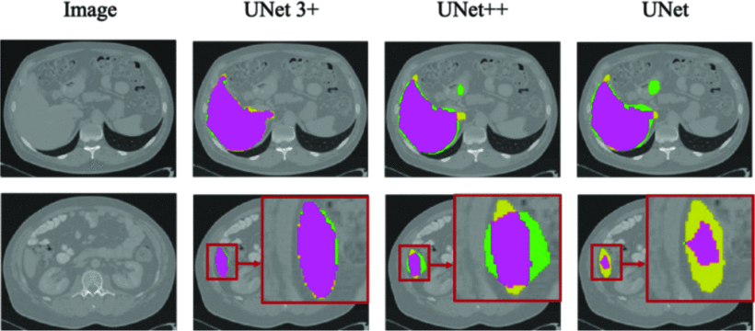
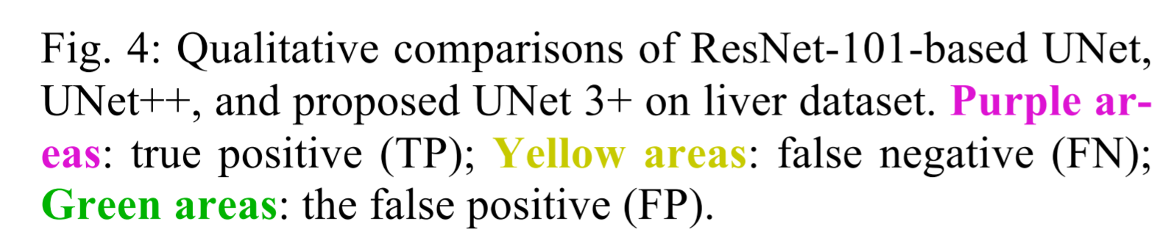
Experiment

Slide 12
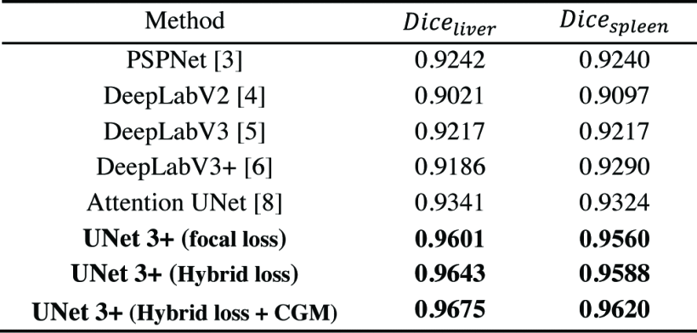
Experiment

Slide 13
Conclusion
提出了一种具有深度监督的全尺寸连接U-Net，命名为U-Net 3+，最大限度地利用全尺寸特征图，以更少的参数实现准确的分割和高效的网络架构
进一步引入分类引导模块和混合损失函数，以产生更准确的位置感知和边界感知分割图。

Slide 14
谢谢

